Slide 1
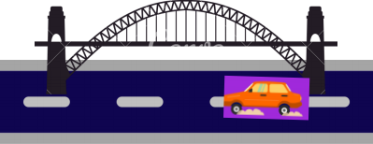





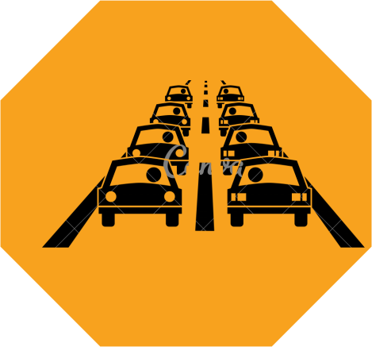


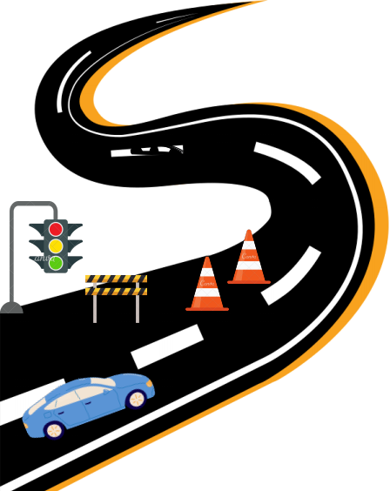


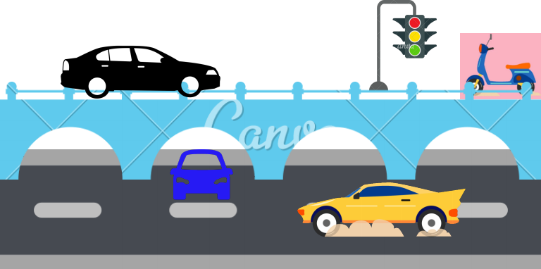

Life
Frequency
(frequency identifier)
Done By
T Dharma Nithin
M.Harika
R.Lahari
Danish
Intelligent traffic system provides a
solution to these problems with the help of new
technologies.
LOGO
PROBLEM
STATEMENT
When a bridge/flyover collapse
their is a immense loss of people
who are under the bridge.To detect
the exact location of people to
rescue them we will use a sensor
which will be present inside the
vehicles we can also use these
sensor in drones. This sensor will
help us to detect the vehicles we
can use these to save the human
lifes fastly.
Due to this emergency services like ambulance, fire fighting vehicles, police vans etc are not being able to reach the destination on time.
Across cities more people are spending more time sitting in traffic
jams.
The key factors behind traffic congestion include road works,
accidents, traffic overload on the same route, and large
numbers of pedestrians holding up the vehicles. Although all
these factors can be managed relatively easily, surprisingly
not a lot of solutions have been provided thus far.
The solution we brought is
We use a life frequency device(frequency
identifier) to identify the signal which is present
in the vehicles.We use a chip which is placed
inside metal box ,this metal box is used to
protect the chip.

